Slide 1
Database
Day - 1

Slide 2
Overview
Database Introduction
ER Diagram
EER Diagram
Relational mapping
Day 1

Slide 3
What is a Database?
What is a Database Management System?
A database is a collection of related data.
Definition : A database is a persistent, logically coherent collection of inherently meaningful data, relevant to some aspects of the real world.
DBMS is a collection of programs that enables users to create and maintain a database.
Definition : The DBMS is a general-purpose software system that facilitates the processes of defining, constructing, and manipulating databases for various applications
Notes:
What do you understand by ‘Database’?
Answer: Database is an organized collection of related data where the data is stored and organized to serve some specific purpose.
Define DBMS.
Answer: DBMS stands for Database Management System. It is a collection of application programs which allow the user to organize, restore and retrieve information about data efficiently and as effectively as possible.
Define RDBMS.
Answer: Relational Database Management System(RDBMS) is based on a relational model of data that is stored in databases in separate tables and they are related to the use of a common column. Data can be accessed easily from the relational database using Structured Query Language (SQL).
What do you understand by Data Redundancy?
Answer: Duplication of data in the database is known as data redundancy. As a result of data redundancy, duplicated data is present at multiple locations, hence it leads to wastage of the storage space and the integrity of the database is destroyed.

Slide 4
Data Models
Data models define how the logical structure of a database is modeled. Data Models are fundamental entities to introduce abstraction in a DBMS. Data models define how data is connected to each other and how they are processed and stored inside the system.
Entity-Relationship model
Relation model
Schema–the logical structure of the database.
Instance–the actual content of the database at a particular point in time.

Slide 5
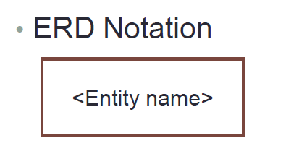
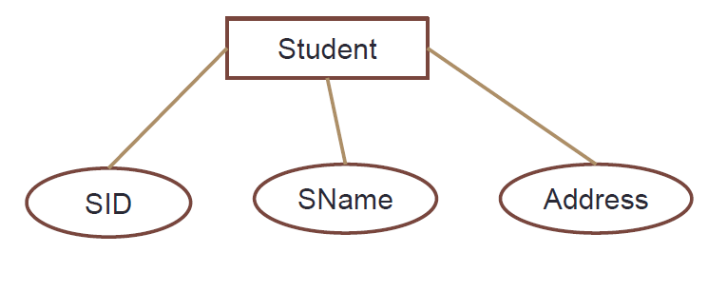
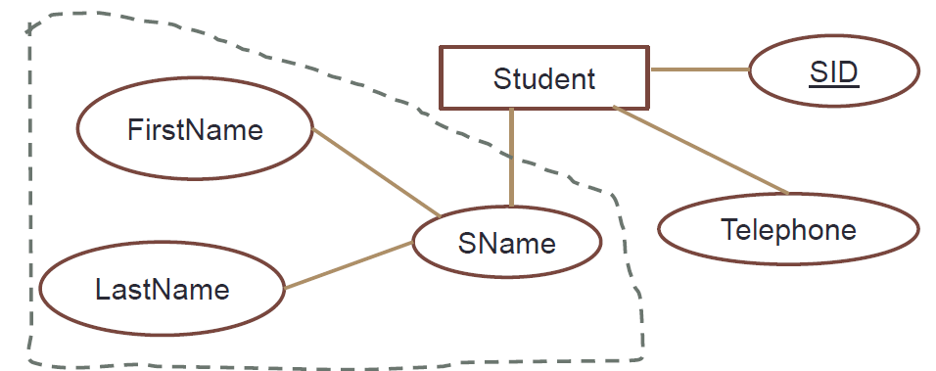
Entity
An entity in an ER Model is a real-world entity having properties called attributes.
Attributes
Entities have attributes that together describes the entity. Each attribute has a data type.
Composite Attributes
Attributes are further divided in a tree like Structure. (eg: Address)

Slide 6

b. Single Valued Attribute
Single-valued attributes contain single value.
c. Multi-Valued Attribute
If an attribute can have more than one value it is called an multivalued attribute.
d. Derived Attribute
Derived attribute is an attribute based on another attribute.
Circle Area can be derived from the Radius.
Age can be derived from DOB (data of birth).
Derived attributes are derivable from Stored Attributes.

Slide 7
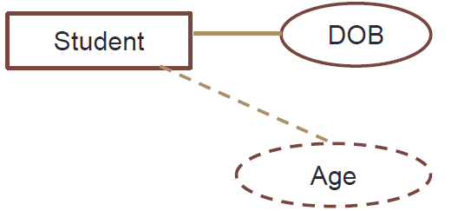
Eg : DOB is a Stored Attribute while Age is a
Derived Attribute
e. Identifier Attributes
Key will identify specific instance in the entity class.
Types of keys may vary according to following criterias;
Uniqueness
Keys may be unique or non-unique
If the key is unique, the data value for the key must be unique among all instances of the entity
Composite
A composite key consists of two or more attributes
It gains uniqueness by combining two or more attributes E.g. Flight Number and Flight Date

Slide 8
Candidate Key
Candidate keys are defined as the set of attributes from which primary key can be selected.
It is an attribute or set of attribute that can act as a primary key for an entity (or table) to uniquely identify each instance in that entity.
Primary Key
Primary key is a candidate key that is most appropriate to become main key of the entity .
Foreign Key
A foreign key is a column or group of columns in a relational database table that provides a link between data in two tables. It acts as a cross-reference between tables because it references the primary key of another table, thereby establishing a link between them.

Slide 9
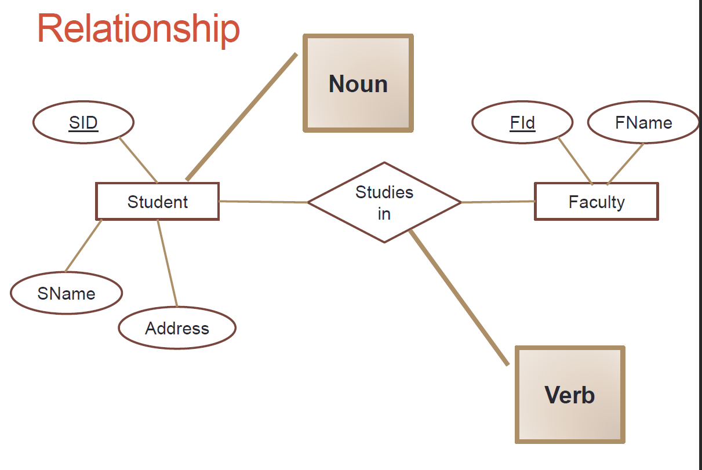
Relationship

Slide 10
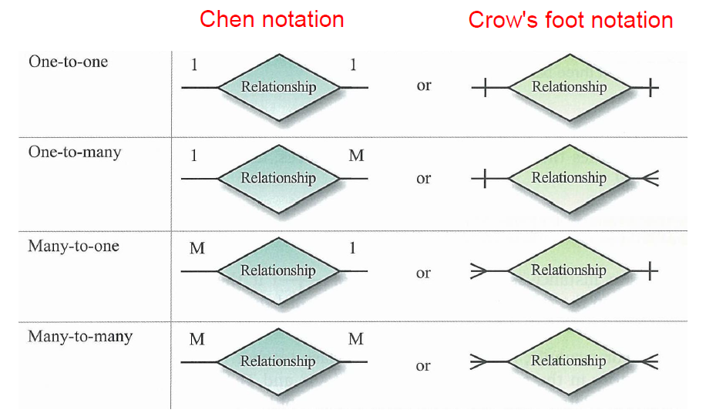
Cardinality
The number of instances of one entity that can or must be associated with each instance of another entity.
•One to one
•One to many
•Many to many
(Maximum Cardinality)

Slide 11
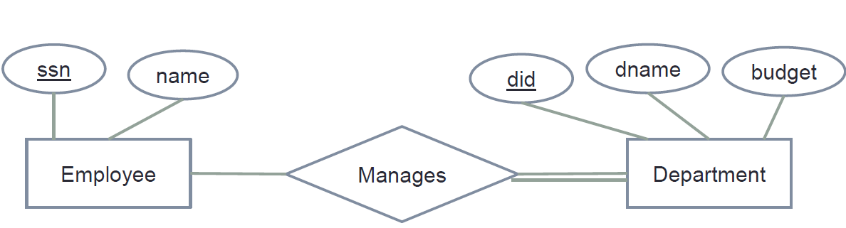
Total Participation
E.g. : If a company policy states that every employee must work for a department, then an employee entity can exist only if it participates in at least one Works_for relationship instance.
Does every department have a manager?
Every employee does not manage a department.
Therefore, the participation of Employee in the Manages relationship type is partial

Slide 12
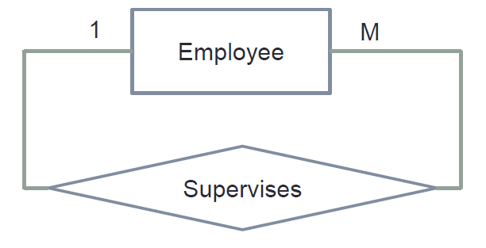
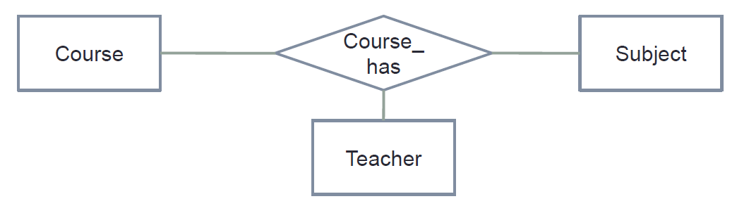
Degree of Relationship
It describes the number of entities involved in a relationship.
Unary (one entity)
Binary (two entities)
Ternary (three entities)
N’ary(more than 3 entities)

Slide 13
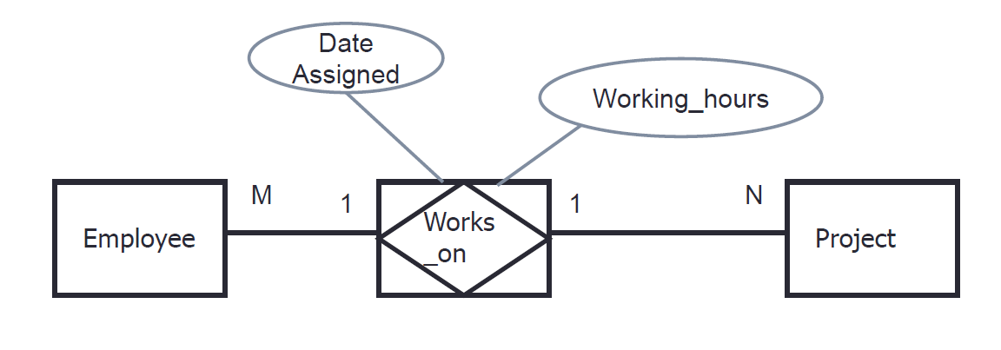
Associative Entity

Slide 14
Weak Entity
A weak entity depends on the existence of another entity.
Weak entity is an entity type that, in addition to being existence dependent, has a primary key that has been totally or partially constructed from the entity it depends on.
A weak entity can be identified uniquely only by considering the primary key of another (owner) entity.

Slide 15
ER Scenario
The university database stores details about university students, courses, the semester a student took a particular course (and his mark and grade if he completed it), and what degree program each student is enrolled in.
The database is a long way from one that’d be suitable for a large tertiary institution, but it does illustrate relationships that are interesting to query, and it’s easy to relate to when you’re learning SQL.

Slide 16
Consider the following requirements list:
The university offers one or more programs. (eg:- IT, ITM,...)
A program is made up of one or more courses.(eg :- DBMS,)
A course cannot be in multiple programs.
A student must enroll in a program.
A student takes the courses that are part of her program.
A program has a name, a program identifier, the total credit points required to graduate, and the year it commenced.(IT - 2001, ITM -2010)
A course has a name, a course identifier, a credit point value, and the year it commenced.
Students have one or more given names, a surname, a student identifier, a date of birth, age and the year they first enrolled. We can treat all given names as a single object—for example, “John Paul.”
When a student takes a course, the year and semester he attempted it are recorded. When he finishes the course, a grade (such as A or B) and a mark (such as 60 percent) are recorded.
Each course in a program is sequenced into a year (for example, year 1) and a semester (for example, semester 1).

Slide 17
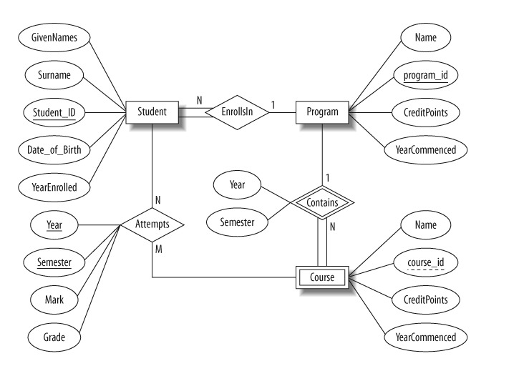
ER diagram

Slide 18
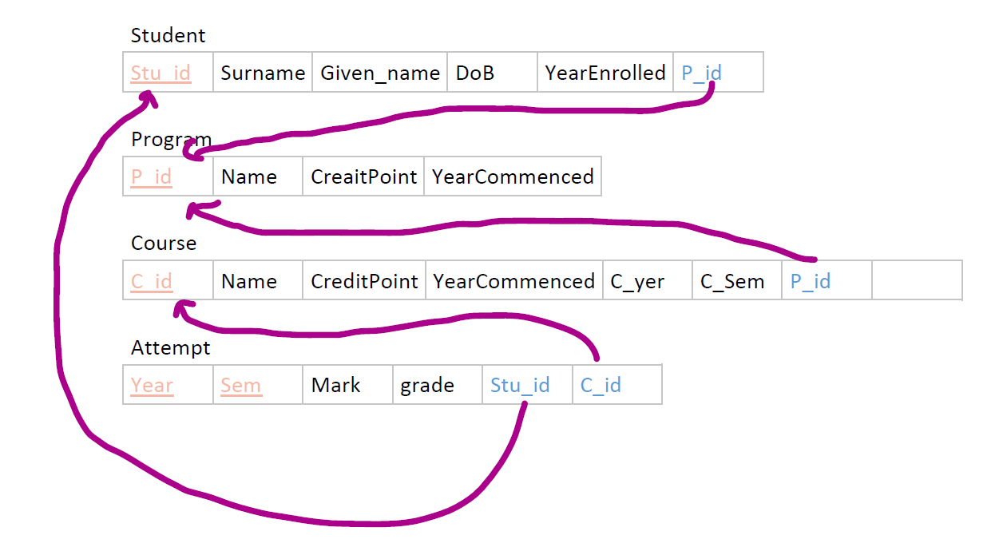
ER to Relational
Mapping

Slide 19
EER (Enhanced ER)
Superclass: An entity type that represents a general concept at a high level.
Subclass: An entity type that represents a specific concept at lower levels.
Specialization: A means of identifying sub-groups within an entity set which have attributes that are not shared by all the entities (top-down).
Generalization: Multiple entity sets are synthesized into a higher-level entity set, based on common features (bottom-up).

Slide 20
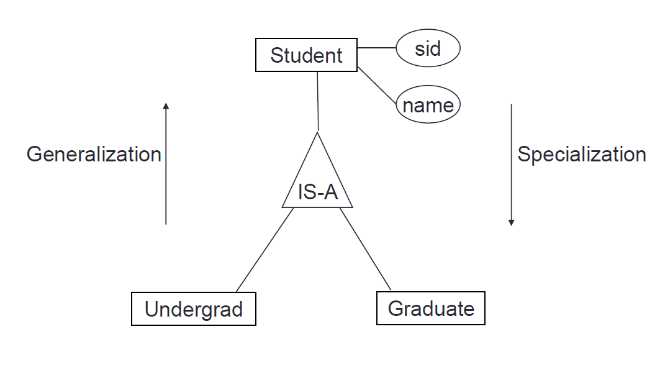
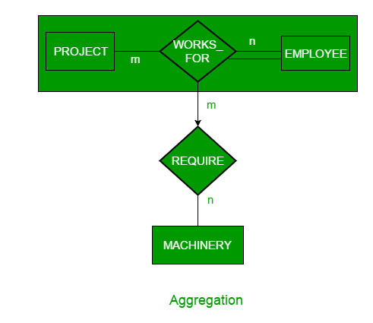
Example

Slide 21

Aggregation
Aggregation represents a ‘has-a’ relationship between entity types, where one represents the ‘whole’ and the other the ‘part’.
An example of aggregation is the Car and Engine entities. A car is made up of an engine. The car is the whole and the engine is the part. Aggregation does not represent strong ownership. This means, a part can exist on its own without the whole. There is no stronger ownership between a car and the engine. An engine of a car can be moved to another car.

Slide 22

Composition
Composition is a form of aggregation that represents an association between entities, where there is a strong ownership between the ‘whole’ and the ‘part’. For example, a tree and a branch have a composition relationship. A branch is ‘part’ of a ‘whole’ tree - we cannot cut the branch and add it to another tree.

Slide 23
Relational Model Concept
Database as a collection of relations
each relation resembles a table of values
row is called a tuple, column header is called an attribute and a table is called a relation.

Slide 24
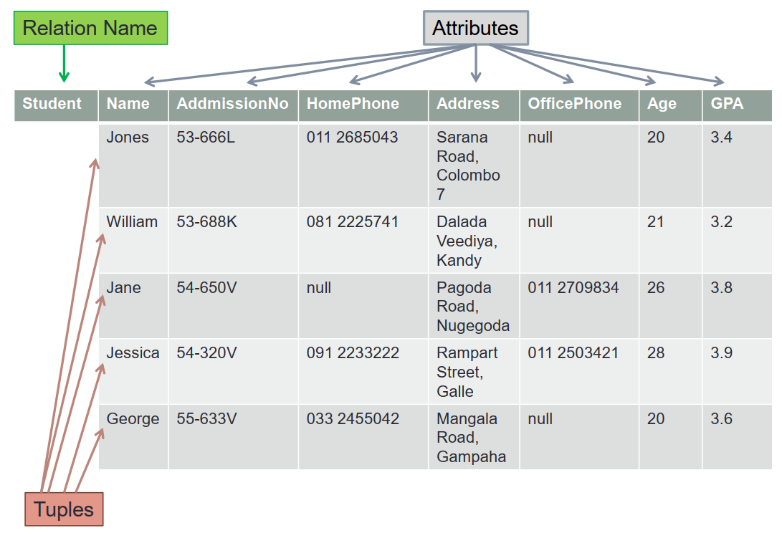
Relational Model (Cont.)
Example

Slide 25
Map ER to Relational Model
7-Step Process:
Map Regular Entity Types
Map Weak Entity Types
Map Binary 1:1 Relation Types
Map Binary 1:N Relationship Types.
Map Binary M:N Relationship Types.
Map Multivalued attributes
Map N-ary Relationship Types

Slide 26
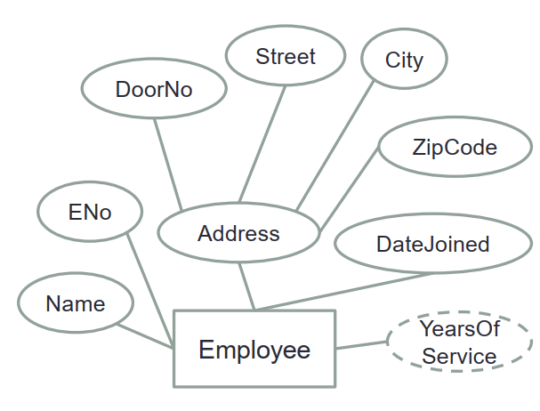
Step 1
Employee (ENo, Name, DoorNo, Street, City, ZipCode,DateJoined)
Notes:
Each entity type becomes a table
• Each single-valued attribute becomes a column
• Derived attributes are ignored
• Composite attributes are represented by components
• The key attribute of the entity type becomes the primary
key of the table

Slide 27
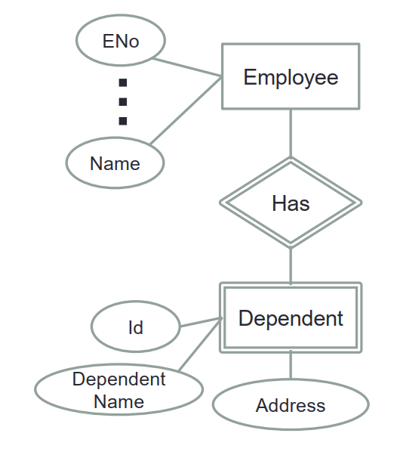
Step 2
Employee (ENo ,…….)
Dependant (EmployeeId, DependantId, DependentName, Address)
Notes:
Weak entity types are converted into a table of their own, with the primary key of the strong entity acting as a foreign key in the
table
This foreign key along with the key of the weak entity form the composite primary key of this table .

Slide 28
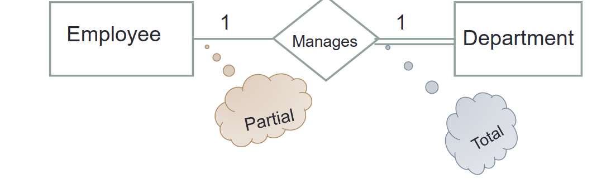
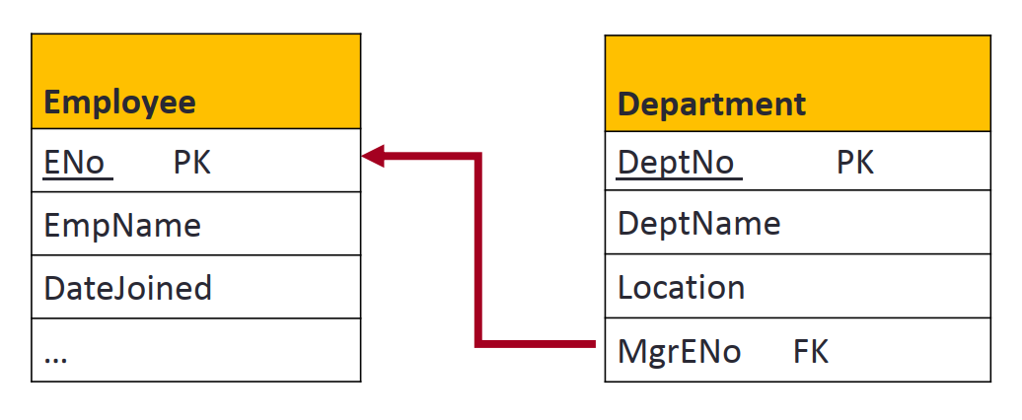
Step 3
Case 1 -
Notes:
The primary key of the partial participant will become the
foreign key of the total participant
Attribute on Relationship goes to the Total Participant Side

Slide 29
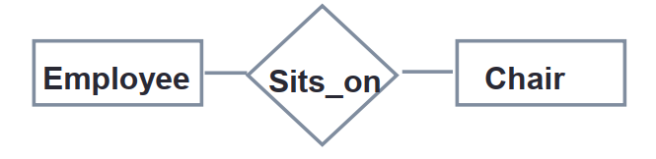
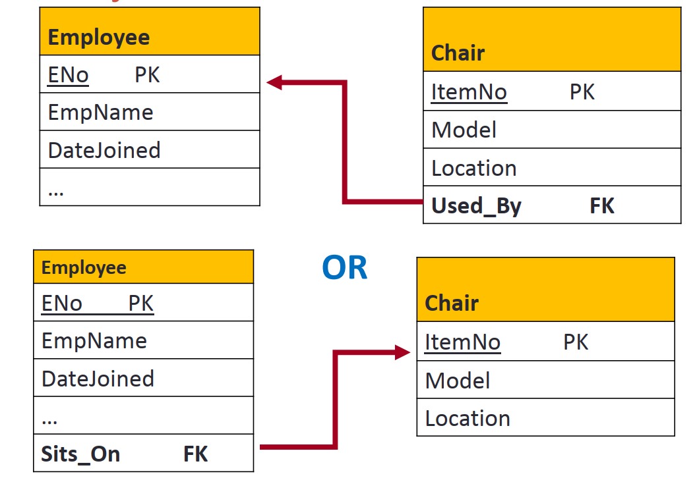
Step 3
Case 2
Notes:
The primary key of either of the participants can become a foreign key in
the other

Slide 30
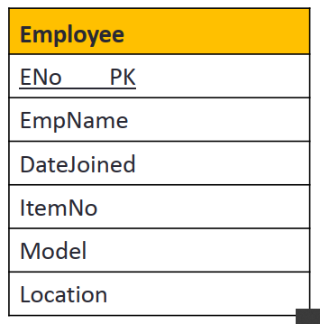
Step 3
Case 3
both participations are total
Notes:
If both participations are total, “merge relation
option” could be used. That is, Merging the two entity
types and the relationship into a single relation.

Slide 31
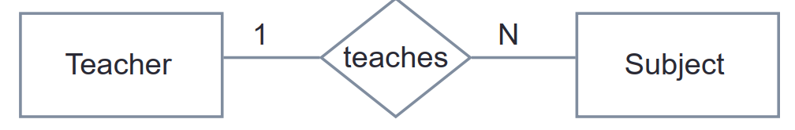
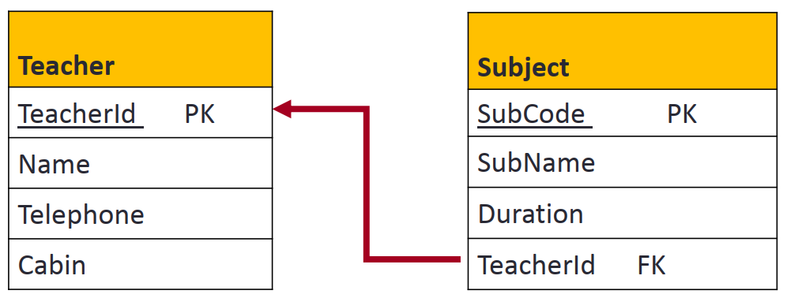
Step 4
Teacher (TeacherId, Name, Telephone, ...)
Subject (Code, Name, ..., TeacherId)
Notes:
The primary key of the relation on the “1” side of the
relationship becomes a foreign key in the relation on the
“N” side.

Slide 32
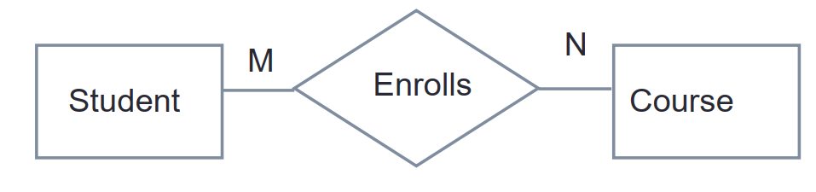
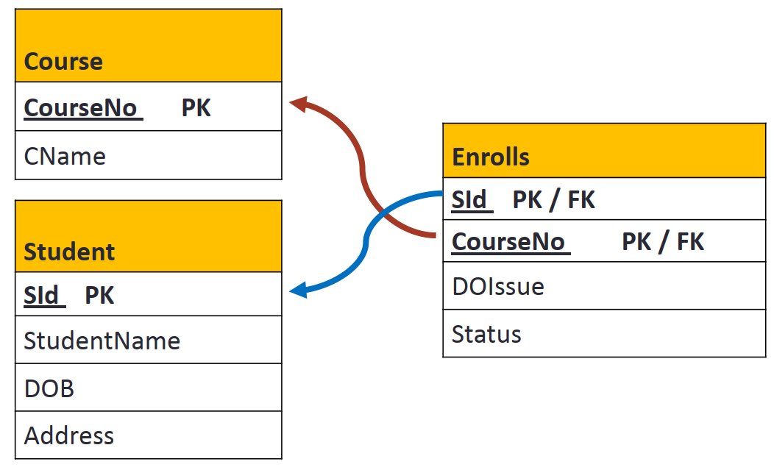
Step 5
Student (SId,Title…)
Course(CourseNo,CName,…)
Enrolls (SId, CourseNo)
Notes:
A new table is created to represent the relationship
It will be a lookup table
It contains two foreign keys - one from each of the participants in the
relationship
The primary key of the new table is the combination of the two foreign keys

Slide 33
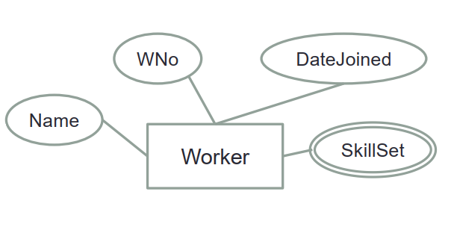
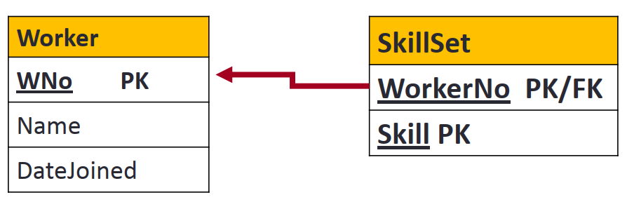
Step 6
Worker(WNo, Name, DateJoined)
SkillSet( WorkerNo, Skill)

Slide 34
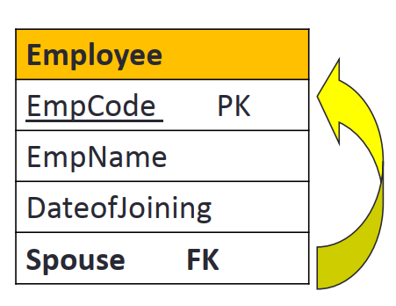
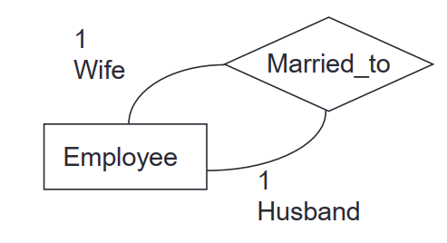
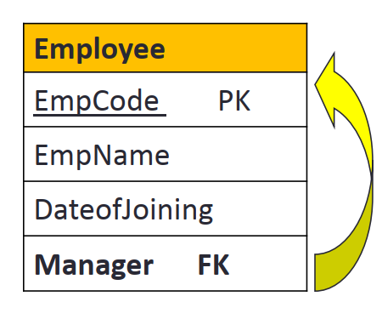
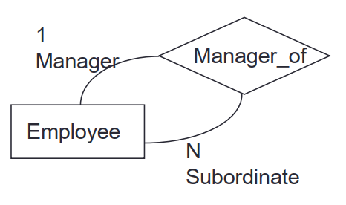
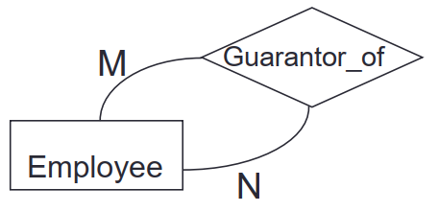
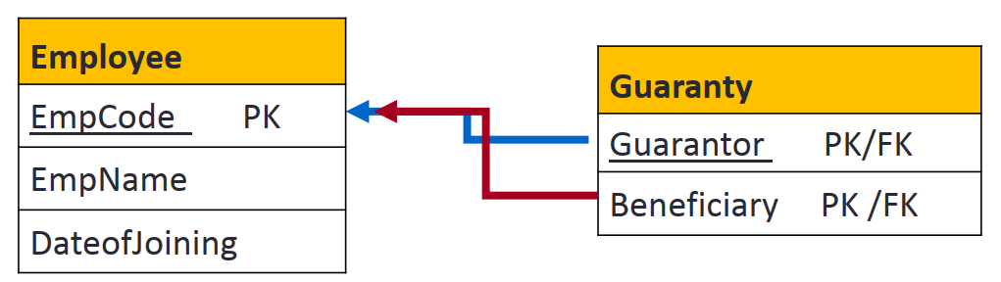
Step 7
Employee( ENo, Name,... Spouse)
Employee( ENo, Name, …, Manager)
Employee( ENo, Name,…)
Guaranty( Guarantor, beneficiary)

Slide 35
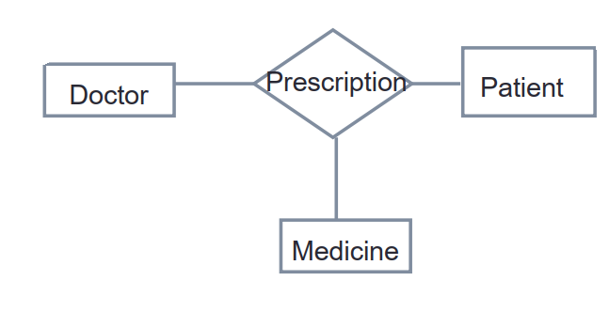
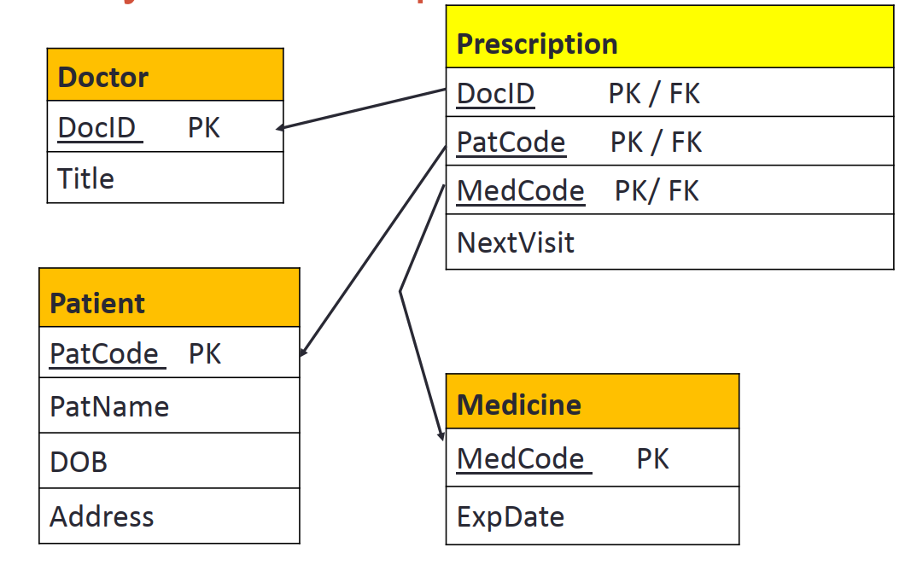
Step 7
Prescription (DoctorNo, PatientNo, MedicineCode)

Slide 36
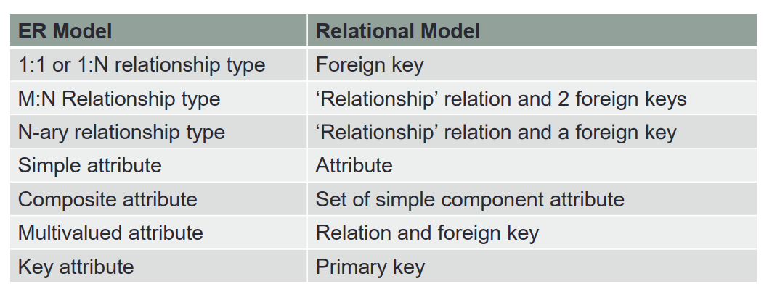
Relation Mapping Summary

Slide 37
Database
Day 2

Slide 38
Overview
Normalization
SQL:
Tables
Joins
Aggregates
Transactions
Views
Triggers
Stored Procedures
Indexes / Hashing
Day 2

Slide 39
Normalization
WHY ?

Slide 40
First Normal Form
All the attributes in a relation must have atomic values.
No Composite Attributes
No Multivalued Attributes
No Nested Relations

Slide 41
Name | Age | Degree
Chiranga Wickramasinghe | 26 | IT
Piumi Perera | 24 | IT
Chameera Dulanga | 24 | IT
First Name | Last Name | Age | Degree
Chiranga | Wickramasinghe | 26 | IT
Piumi | Perera | 24 | IT
Chameera | Dulanga | 24 | IT

Slide 42
Student | Age | Subject
Chiranga | 26 | Bio
Chiranga | 26 | Chemistry
Piumi | 24 | Maths,
Piumi | 24 | Physics
Chameera | 24 | Maths
Student | Age | Subject
Chiranga | 26 | Bio, Chemistry
Piumi | 24 | Maths, Physics
Chameera | 24 | Maths
But, Data redundancy increases

Slide 43
Id | Name | ProjNum | Hours
1 | Smith | 1 2 | 10 15
2 | John | 2 3 | 25 23
3 | James | 1 3 | 5 4
Id | ProjNum | Hours
1 | 1 | 10
1 | 2 | 15
2 | 2 | 25
2 | 3 | 23
3 | 1 | 5
Id | Name
1 | Smith
2 | John
3 | James

Slide 44
Second Normal Form
• Every non-prime attribute should be fully functionally dependent on the primary key.

Slide 45
EmployeeId | PNumber | Hours | EName | PName | PLocation
EmployeeId | PNumber | Hours
EmployeeId | EName
PNumber | PName | PLocation

Slide 46
Third Normal Form
• No non-prime attribute should transitively dependent on the primary key.

Slide 47
StudentId | StdName | DOB | City | Zip
StudentId | StdName | DOB | Zip
Zip | City

Slide 48
SQL Queries

Slide 49
Tables
Creating a table
Key Constraints
NULL
DEFAULT
Auto Increment
On update cascade
When we create a foreign key using UPDATE CASCADE the referencing rows are updated in the child table when the referenced row is updated in the parent table which has a primary key.
On delete cascade
When we create a foreign key using this option, it deletes the referencing rows in the child table when the referenced row is deleted in the parent table which has a primary key.
Insert Values to Table
Update records
Delete records
Altering a table

Slide 50
Example
Create a table Admin.
Fields - Aid (Primary key), Name, Pid (Foreign key to Program table), Status
Aid cannot be null and should autoincrement its values starting from 1
Field Status has a data type varchar and has a default value ‘Active’
Insert 2 records into table Admin.
Update the name of your first Admin.
Delete your 2nd admin.
Alter the field ‘Name’ so that it can’t take Null values

Slide 51
General Keywords
Select
Retrieve all the details of every program
Retrieve Name and Student ID of all students
Where
Retrieve the name of all courses that have a credit point greater than 2
Retrieve the name of all courses that have a credit point greater than 2 and belongs to Program Id 1
Retrieve the name of all courses that have a credit point greater than 2 or belongs to program Id 2
Like
Retrieve all the details of courses whose name starts with ‘E’
Order By
Retrieve all the details of attempts and sort in descending order of marks
Distinct
Retrieve all the unique given names of students
Aliases

Slide 52
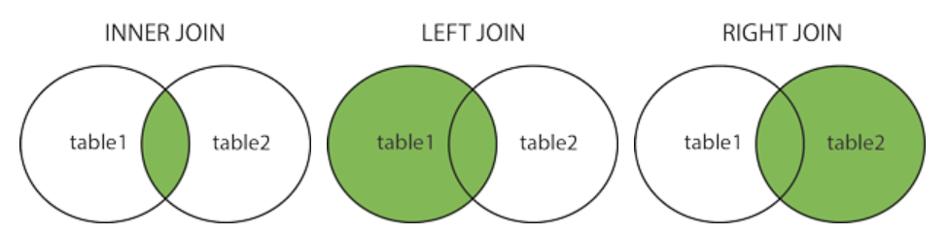
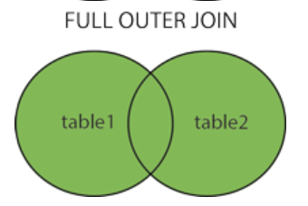
Joins
Inner join - Returns records that have matching values in both tables
Left Outer join - Returns all records from the left table, and the matched records from the right table
Right outer join - Returns all records from the right table, and the matched records from the left table
Full outer join - Returns all records when there is a match in either left or right table

Slide 53
Examples
Retrieve the full name and marks of students who have attempted the course with course id 2
Retrieve the First names and marks of students who have attempted the course Calculus and have scored more than 50 marks.
Retrieve the names and student ids of all the students and the marks of any course attempts they have made if there are any.

Slide 54
Aggregates
An aggregate function performs a calculation on a set of values, and returns a single value.
Except for COUNT(*) , aggregate functions ignore null values. Aggregate functions are often used with the GROUP BY clause of the SELECT statement.
COUNT
MIN
MAX
AVG
SUM

Slide 55
Examples
Retrieve the number of students who have scored more than 50 marks on any attempt
Retrieve the maximum mark obtained for the course accounting
Retrieve the minimum mark obtained for the course Accounting
Retrieve the Average mark obtained by students for the subject Calculus
Retrieve the sum of marks of all attempts.

Slide 56
Transactions
A transaction is a sequence of operations performed (using one or more SQL statements) on a database as a single logical unit of work. The effects of all the SQL statements in a transaction can be either all committed (applied to the database) or all rolled back (undone from the database).
Properties:
A (Atomicity) - The transaction sub units must all be completed or none at all
C (Consistency) - At the end of the transaction data is consistent with the rules of the DB (Ex: constraints, cascades, triggers)
I (Isolation) - Modifications made by 1 transaction is independent of the other
D (Durability) - When transaction is complete, its effects are permanent

Slide 57
Understand the concept of a transaction
To understand the concept of a transaction, consider a banking database. Suppose a bank customer transfers money from his savings account (SB a/c) to his current account (CA a/c), the statement will be divided into four blocks :
Debit SB a/c.
Credit CA a/c.
Record in Transaction Journal
End Transaction

Slide 58
Start the transaction.
START TRANSACTION;
The SQL statement to debit SB a/c is as follows:
UPDATE sb_accounts
SET balance = balance - 1000
WHERE account_no = 932656 ;
The SQL statement to credit OD a/c is as follows:
UPDATE ca_accounts
SET balance = balance + 1000
WHERE account_no = 933456 ;
The SQL statement for record in transaction journal is as follows:
INSERT INTO journal VALUES
(100896, 'Tansaction on Benjamin Hampshair a/c', '26-AUG-08' 932656, 933456, 1000);
The SQL statement for End Transaction is as follows :
COMMIT WORK;

Slide 59
Keywords
BEGIN TRANSACTION
Start point of an explicit transaction
SET TRANSACTION
Places a name on the transaction
COMMIT
Saves all changes to the database since the last commit/rollback
ROLLBACK
In case of an error, reverses all changes made since the last commit/rollback
SAVEPOINT
A point in the transaction where you can rollback to without reversing the whole transaction

Slide 60
Views
A view is a virtual table based on the result set of an SQL statement.
Ex:
CREATE VIEW [Brazil Customers] AS
SELECT CustomerName, ContactName
FROM Customers
WHERE Country = "Brazil";
SELECT * FROM [Brazil Customers];

Slide 61
Stored Procedures
A stored procedure is a prepared SQL code that you can save, so the code can be reused over and over again.
CREATE PROCEDURE SelectAllCustomers
AS
SELECT * FROM Customers
GO;
EXEC SelectAllCustomers;

Slide 62
Triggers
A trigger is a stored procedure in database which automatically invokes whenever a special event in the database occurs.
Events: Before / After
Insert
Update
Delete

Slide 63
Syntax
create trigger [trigger_name]
[before | after]
{insert | update | delete}
on [table_name]
[for each row]
[trigger_body]

Slide 64
Indexes
Indexes are a data structure that is used to retrieve data from the database very fast.
Indexes are special lookup tables that the database search engine can use to speed up data retrieval. Simply put, an index is a pointer to data in a table.
An Index has only two columns. The first column comprises a copy of the primary or candidate key of a table. Its second column contains a set of pointers for holding the address of the disk block where that specific key value stored.
An index helps to speed up SELECT queries and WHERE clauses, but it slows down data input, with the UPDATE and the INSERT statements. Indexes can be created or dropped with no effect on the data.

Slide 65
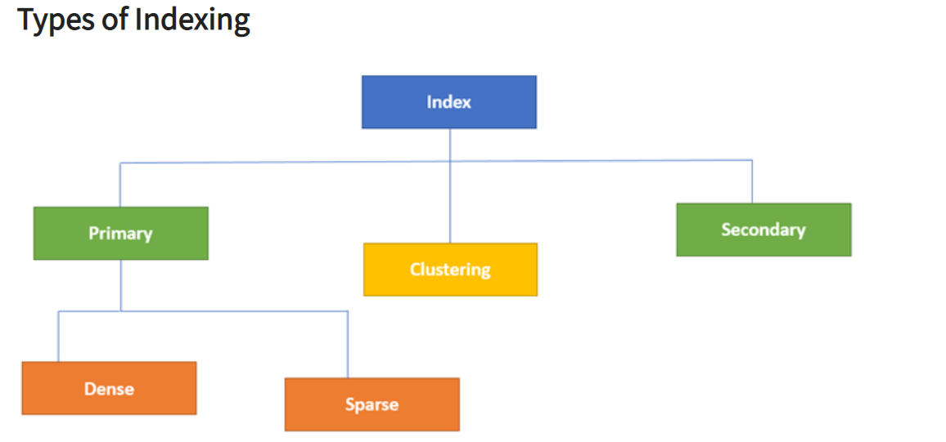

Slide 66
Primary Indexes
The first field is the same a primary key and second field is pointed to that specific data block.
In the primary Index, there is always one to one relationship between the entries in the index table.
Dense Index - A pointer exists for every record
Sparse Index - Only contain entries for documents that have the indexed field

Slide 67
Secondary Indexes
Clustered Indexes
The secondary Index in DBMS can be generated by a field which has a unique value for each record, and it should be a candidate key.
It is also known as a non-clustering index.
A clustered index defines the order in which data is physically stored in a table. Table data can be sorted in only way, therefore, there can be only one clustered index per table

Slide 68
Hashing
Hashing is a technique to directly search the location of desired data on the disk without using index structure.
For a huge database structure, it's tough to search all the index values through all its level and then you need to reach the destination data block to get the desired data.
Data is stored in the form of data blocks whose address is generated by applying a hash function in the memory location where these records are stored known as a data block or data bucket.

